Slide 1




BAKHTIYOR RAKHMATULLAEV
210064
CTO Bobirjon Karimov
210060
CEO – Vision, Strategy & Leadership
CTO - Growth, Market Intelligence & Strategic Partnerships
Akbar Aminov
210059
Aziza Sarsenbaeva
210003
Madina Ortikova
210050
Mukhiddin Rajabmukhammedov
210039
COO – Operations & Execution
CMA – Marketing & Brand Growth
CFO – Finance & Budgeting
CSA – Customer Needs & Support Vision

Slide 2





Slide 3



NEXT-GEN CRM SOLUTECH SYSTEM
Enhancing Business Efficiency

Slide 4
CEO - 210064
70%
30%
Waste up time just for switching tools
20%
Waste up to their employee’s time
Lose up clients due to poor relationship

Slide 5
CEO - 210064
Uncontrolled Project Overruns
Loss of Trust and Client Attraction
Ineffective Resource Utilization
Lack of Predictive Insights

Slide 6
CTO - 210060
CRM + PM
Projects
Clients
Team workflows

Slide 7
CTO - 210060
Build only what you need !
• Rise of remote & hybrid teams
• Freelancers & Digital Agencies
• IT & Service Teams in growing markets
10

Slide 8
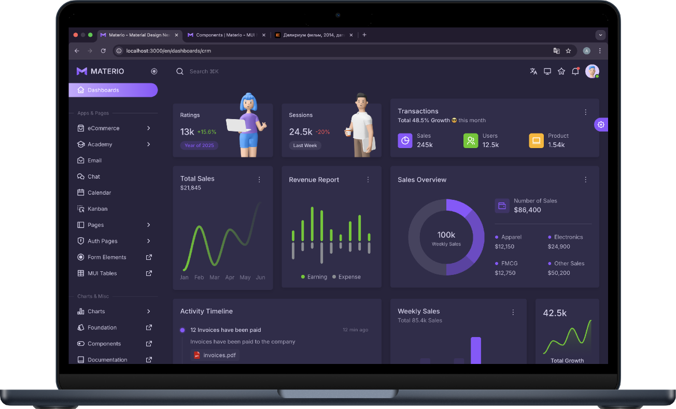
CTO - 210060

Slide 9


CTO - 210060
Modular & API-first architecture
Cloud-native stack (AWS/GCP)
Speed & adaptability.
09

Slide 10
CFA - 210050
Scalable
Sustainable
Usage Based
Customizable
Modular

Slide 11


CFA - 210050
Financial Planning & Budgeting
• Sustainable monetization
• Smart cost optimization
• Scalable financial model
• Risk & compliance control

Slide 12
CMA - 210003
Content Marketing
DEMO
Strategic Partnerships
Sales Team Engagement

Slide 13
COO - 210059
Ensure seamless execution with minimal friction.
Streamlined workflows & SOPs
Risk management & mitigation
Team efficiency & vendor control
Scalable delivery operations

Slide 14
CSA - 210039
Sales Strategy & Revenue
B2B/B2C sales channels
Targeted customer outreach
Effective sales
pipeline

Slide 15
CEO - 210064
Long-term value creation
Strategic partnerships
Data-driven decisions
Lead with innovation & adaptability

Slide 16
Question
&
Answer

